Slide 1




Media & Publicity

Slide 2
Contents
Sophia’s Professional Bio | 3
Sophia’s Previous PR Clients | 4
Feedback from PR & Coaching Clients | 5-6
Sophia’s PR services | 7-8
Previous Client Campaign Examples | 9-17
Hugo Boss | 9-11
Go Ahead | 12-15
Fox Films | 16-17
Further examples of previous PR work | 18
Contact Sophia | 19

Slide 3
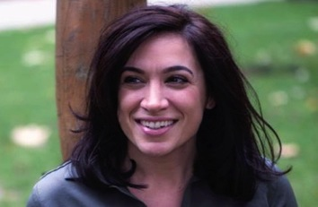
Sophia Davis
Life Coach, EFT Master Practitioner, Energy Specialist
Sophia Davis is an author, inspirational speaker and expert in human behaviour. She is also a life coach, an EFT Master Practitioner, an energy specialist and Reiki Master Teacher. Best known for facilitating life-altering transformations for her clients, Sophia is fast becoming the UK's leading voice in the field of coaching, consciousness and inner change.
Sophia initially worked with Look Magazine as their resident life coach, but since then has written features for numerous women's weekly and monthly publications including: Cosmopolitan, Women’s Fitness, Closer, The Huffington Post, FHM and Bliss, amongst others. She has also featured on BBC London Radio, BBC 3 Counties, and Foxy Radio and worked with top Global brands such as Hugo Boss, Filofax, Kalms, Go Ahead and Fremantle Media.
Sophia is as unique as her methods. Over the past decade Sophia learned the skills and gained the experience needed to transform her own life and after a life shattering event occurred. A charismatic bundle of positive energy she is passionate about sharing her unique combination of skills, experience, and wisdom to help empower others to live a life of love, fulfillment, purpose and happiness.
This woman is the real deal - not only is she a brilliant coach but she possesses a rare combination of wisdom and intuition that brings a whole new dimension to working with her. She has truly changed my life for the better and I have achieved things that I never thought possible. My life is richer, happier and more peaceful for having worked with Sophia - the results really speak for themselves. I can't recommend her highly enough. She is truly worth her weight in gold. Natalie, 36
I can't thank you enough for today's session! It was a massive breakthrough that felt like a total miracle. You never cease to amaze me with your endless solutions and novel techniques, quite astonishing really that you have something for everything. You truly are the best life coach on the planet bar none and I’m eternally grateful. Thank you!! Ed, 40

Slide 4






















Slide 5
Sophia has received widespread positive feedback from Media clients
Sophia is the best in her game. Great in front of the camera but also on a personal level. Willing to go above and beyond for the cause and everyone she meets wants to work with her again and again. Capable of flipping every situation on it’s head and helping to take the best out of it, I’ve never left Sophia without a smile on my face. Highly recommend from a PR point of view, great brand spokesperson with wide media appeal. Sophie Raine, Frank PR
We received great feedback from our media guests, they really loved the way you creatively dovetailed your insights with our internal expertise for the launch of our new female fragrance. They all welcomed the opportunity to pause for a moment to be mindful, take stock of their hectic lives and envision positive outcomes for situations which may have been causing them stress. It was great to work with you and thanks again for taking the time to listen to ensure you produced a bespoke solution to our needs. Trudy Cox, P&G Fragrances
When launching a new female fragrance that was inspired by an element of a woman's life that until now has gone unnoticed: more specifically taking time out of her day routine, slowing down, and simply enjoying a moment for herself, we wanted to work with an expert who represented this concept and could share their insights to key beauty press. Through WOM and highly sought after recommendations we were introduced to Sophia, an inspiring woman who denotes the essence of the fragrance. Sophia was kind enough to share her experiences and practices to the UK press to give them an insight into 'taking a moment to themselves'.
The presentation itself was extremely engaging and educating with press stating: 'Sophia has taught me so much about myself in just 20 minutes' and 'I feel like a new woman’. Sophia brought the fragrance to life and we were thrilled that she was part of this campaign. Olivia Pasmore, Talk PR
Sophia’s involvement in the Kalms Annual Stress Report was invaluable in terms of the insight that she brought to the project. Her ability to deliver within tight deadlines and to specific brief requirements helped progress activity quickly and easily, and her advice was professional and considered to bring interesting content to the project. I would recommend and work with her again in the future.” Lisa Davey Bray Leino - Kalms
“Sophia was a delight to work with – from her enthusiasm for the brand, to her accessible and informative content, we couldn’t have asked for more when it comes to an expert partnership. Would definitely recommend working with her for upcoming brand collaborations, for reliability, media know-how and personality.” Georgie Bentinck, 3 Monkeys Communications

Slide 6
And just some of the wonderful feedback Sophia receives
from her coaching clients….
Sophia has changed my life. I am becoming the best me that is possible which is a truly illuminating thought, and a place I believe I never would have come close to without her. She has opened up this possibility to me and, in her own words, she has helped me choose to be open to a different possibility. I honestly feel completely different because of Sophia and that's a constant delight everyday. I feel lighter and I feel anticipatory for what is to come now as a result. Liz, 38
Sophia is like no other person I have met before, she radiates positivity and happiness, giving you a new path in life. Sophia has helped me to love all of myself and have compassion for everything in my world. She has helped me to become the person I am and want to be - loving, compassionate, truly happy and loving life. Sophia is not only a great life coach who gives you a whole new perspective on life but she is a truly amazing individual who has been where you are and has become one of the most compassionate and loving people with a zest for life that is infectious. Amanda, 42
I feel like a whole new person. I was suffering from PTSD, stressed out, depressed, chronically fatigued and anxious. Sophia has helped me get rid of all of those problems. I feel free, at peace, happy and energized, and I do not have a single worry. I can confidently say that I have a whole new way of looking at things, and a whole new way of dealing with things. Terese, 21
I am so grateful to Sophia for the caring, intuitive and loving guidance she has given me. She enabled me to find the right path for myself by making me see things in a new light and by having absolute belief that I will achieve my dreams. Penny, 35
“It has been an enormous privilege to meet Sophia. She has an astonishing insight into human nature, and through my conversations with her, I have gained much self-knowledge and have grown spiritually. It was wonderful to have had the opportunity to know someone who combines such outstanding talent with genuine kindness.” Rabbi Anthony Knopf
“EVERYONE should pay a visit to Sophia Davis who is quite literally the most talented life coach! Thank you for being the most exceptional friend and for such an incredibly useful conversation. One chat with her could change your life! Anna, 28
“Sophia is an amazingly spiritual and pure person. She is intuitive and sensitive. I would highly recommend Sophia to anyone and to trust and listen to her voice and guidance. A true gem.” Elise, 29
What you do is truly life changing for the best!. I totally recommend your Life Coaching to EVERYONE. Your help and advice have changed me and cured my life! You are one very wise lady indeed. If you need improvement in an area of your life everyone, then Sophia Davis is the one to make that happen for you.” Samvida, 30

Slide 7
Sophia Davis has a well established PR Profile
with wide Media Appeal
As one of the UK’s leading experts in the field of coaching, consciousness and inner change, Sophia is gaining national acclaim amongst the media as the go-to girl for how to live life on our terms.
With numerous requests and regular contributions across TV, Radio & Film, Print and with Global Brands, Sophia’s reach and credibility extends wide into the media arena, with her insights, wisdom and knowledge being made widely available beyond her personal coaching clients.
Sophia is a charismatic, inspirational and confident public speaker and brand spokesperson. Understanding the importance of engaging, practical and innovative communications, Sophia loves the opportunity to bring her unique insights and perspective to life through various media channels.
Sophia’s style is extremely versatile, engaging, and fun! She is as impactful and comfortable in front of the camera offering her expert opinion as she is speaking on radio, being interviewed by Press, leading workshops or writing features for some of world’s leading magazines.

Slide 8
Sophia Davis has a well established PR Profile
with wide Media Appeal
Sophia is available for a wide range of PR activities across media channels and can offer expert comment and contribution on a variety of topics across personal development, self help, modern day spirituality and human behavior.
Previous PR engagements have covered a range of topics such as interpersonal relationships, stress and anxiety management, depression, fulfilling our potential and purpose, finding happiness and joy in life, improving self confidence, self esteem and self image and much more.
Sophia is always guaranteed to carefully listen to problems, turn them on their head and offer creative solutions! Previous clients have included:
TV, Film & Radio
Print – Online & Offline
Global Brands
Pilot film for Talkback TV & Sassy
Fox Films
BBC London Radio
BBC London Counties Radio
Foxy Radio
Look Magazine
Cosmopolitan
Closer
FHM
Zest
Women’s Fitness
Huffington Post
Beauty Magazine
Freemantle Media
Hugo Boss
Kalms
Filofax
Tesco
GSK
P&G
LA Fitness

Slide 9
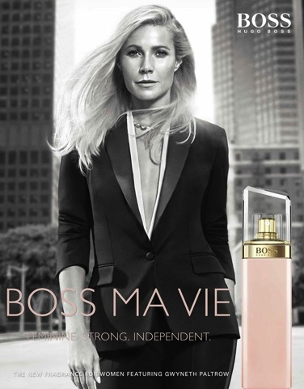
Client Example: Global Brand Representative
for Hugo Boss MA VIE Product Launch
Client: P&G Global Fragrances, Hugo Boss Agency: Talk PR
Client Brief: To support the product launch of the new fragrance from Hugo Boss, MA Vie. The new female fragrance was inspired by taking time out of a women’s daily routine to simply enjoying a moment for herself. Sophia was asked to create and deliver a talk to UK press on how to ‘live in the moment’, combining the message of the brand “Strong, feminine, independent’ with the fragrance concept
Outcome: Sophia gave an inspiring and interactive talk to a group of the UK’s top press. Her talk focused on practical tips and insights on how to slow down and bring more presence and joy into our busy, stressful lives. She incorporated creative practical techniques; a guided visualization and a demonstration of EFT to help release stressful/anxious thoughts and give attendees an experience of being in the present moment. This was complimented by a hand out of “Top tips to savor all the moments of your ‘ultimate’ life” and individual press interviews. Press coverage of the event extended across top UK beauty magazines, with Sophia’s insights featured in Beauty Magazine for example.
We received great feedback from our media guests, they really loved the way you creatively dovetailed your insights with our internal expertise for the launch of our new female fragrance.
Trudy Cox, P&G Fragrances
A big thank you for all the work and effort put into making yesterday’s event so great. We received really positive feedback from attendees - one saying it was one of the best she had been to in terms of content in relation to a product launch.
Louisa Durrant, Talk PR
https://www.youtube.com/watch?v=V4SuTGfTL9o

Slide 10
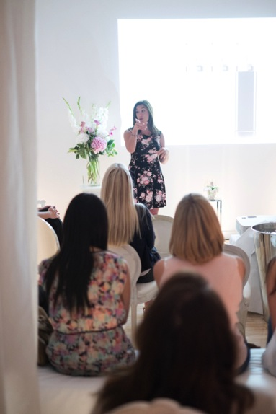
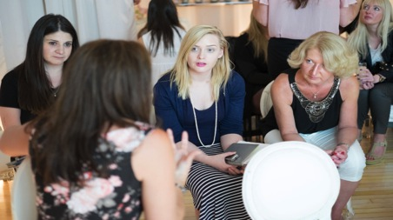
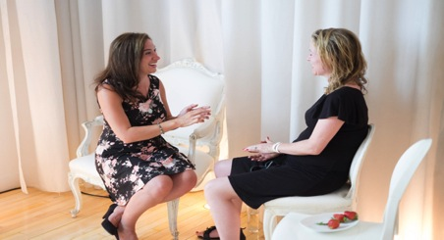
Hugo Boss: Product Launch Presentation
& Interviews with UK Press
Sophia delivering her talk at the Hugo Boss launch event and interviews with Press, “Sophia brought the fragrance to life and we were thrilled that she was part of this campaign”, Olivia Pasmore, Talk PR

Slide 11
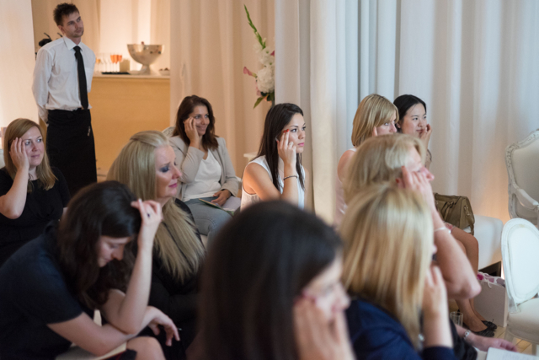
“The presentation was extremely engaging and educating with UK press stating: 'Sophia has taught me so much about myself in just 20 minutes' and 'I feel like a new woman” Olivia Pasmore, Talk PR – Hugo Boss Fragrance launch

Slide 12

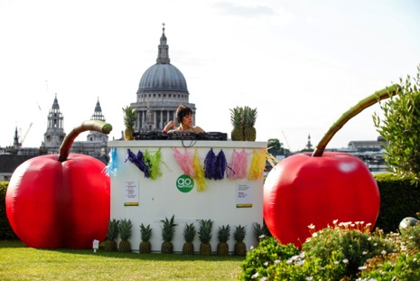
Client Example: Go Ahead “Feel Good’ Product launch
Client: Go Ahead Agency: 3 Monkeys Communications
Client Brief: For the product launch of Go Ahead! new range of healthy biscuits and to support the campaign theme of ‘Feel Good Moments’, Sophia was asked to provide a list of experiences, actions and scenarios that make us “feel good”, with an explanation as to why this makes us happy.
Outcome: The launch event was extremely fun and creative and Sophia’s tips were displayed around the event along with ‘live displays/scenarios’ of her feel good tips. Sophia attended the event to speak with UK press about how to feel good as well as enjoy the evening herself!
Sophia and her feel good advice featured in articles in Women’s Own, Huffington Post and the Daily Express. Closer magazine followed up with Sophia for her input on another article relating to Happiness.

Slide 13
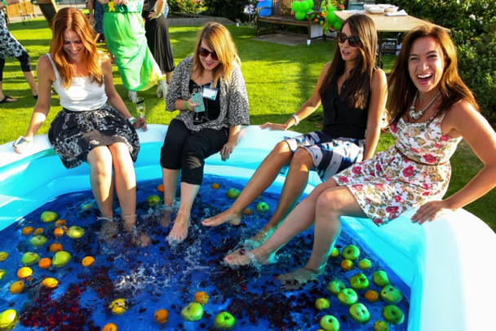
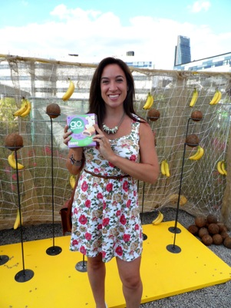
Go Ahead: PR Launch with UK Press
“Sophia was a delight to work with – from her enthusiasm for the brand, to her accessible and informative content, we couldn’t have asked for more when it comes to an expert partnership. I would definitely recommend working with her for upcoming brand collaborations, for reliability, media know-how and personality.”
Georgie, 3 Monkeys Communications

Slide 14

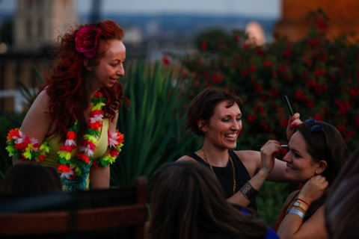

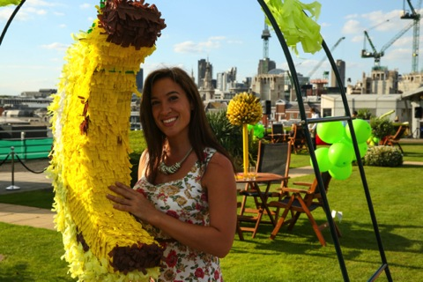

Slide 15
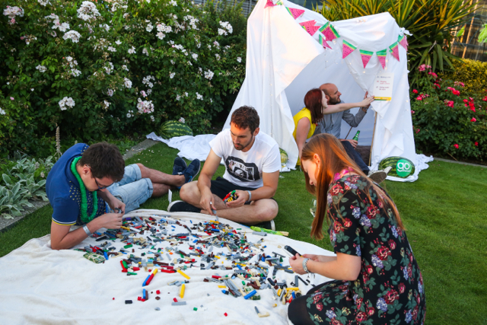
Sophia’s tips on feeling good were distributed around the event venue, with some being creatively produced as live scenarios for the guests to enjoy

Slide 16

Client Example: The Secret Life of Walter Mitty Film Release
Client: Fox Films – The Secret Life of Walter Mitty Agency: Premier Comms
Client Brief: To support PR activities across Online and Radio for the launch of Ben Stiller’s film The Secret Life of Walter Mitty – a story based on James Thurber’s classic of a day-dreamer who escapes his anonymous life by disappearing into a world of fantasies filled with heroism, romance and action.
Outcome: Sophia was chosen as the Life Coach to support the UK release of the film. The messages of the film – that we can all lead an extraordinary life, to follow our dreams and to be bold and brave enough to step into the unknown are sentiments close to Sophia’s heart as a life coach.
Sophia appeared on BBC radio, talking about tips and ideas on how to pursue and live your dreams. Her “essential steps to move out of fear and into a life of love and passion” were also issued with the DVD release and published as an article on the Huffington Post.
I really appreciate all your hard work in helping us out with the campaign. I will definitely keep you in mind for any future projects that come up! Simon, Premier Comms
“To see the world. To find each other and to feel. As Walter Mitty will discover, that is the purpose of life”, Fox Films

Slide 17
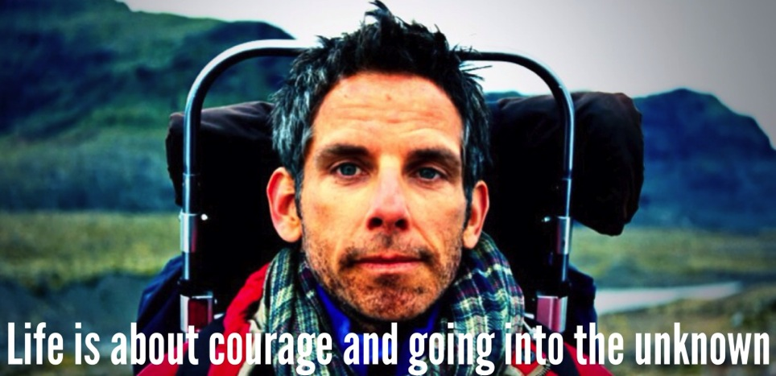


PR for The Secret Life of Walter Mitty Film Release
“You either stand in the safety of your life or run headstrong into the unknown”, Walter Mitty
To listen to Sophia talk on BBC Radio about Walter Mitty, please request the interview directly from Sophia.

Slide 18
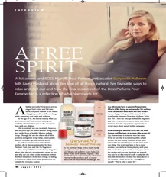
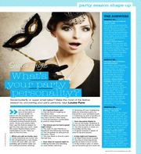
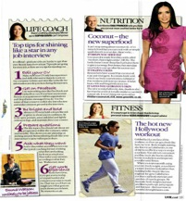
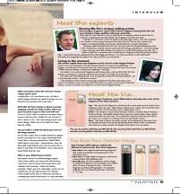
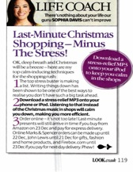

Further examples of Sophia’s PR work
Sophia has written numerous articles for the Huffington Post and here are just a few examples of her work*
http://www.huffingtonpost.co.uk/2011/10/21/five-ways-to-tackle-fear-and-make-it-work-for-you-_n_1023938.html
http://www.huffingtonpost.co.uk/sophia-davis/stepping-out-of-fear-and-_b_4478141.html
http://www.huffingtonpost.co.uk/2011/12/05/over-half-of-brits-go-on-20-identical-dates-a-year_n_1129129.html?just_reloaded=1
*Sophia is happy to provide further examples of her work across media channels if required.
Please contact her directly for more details

Slide 19

Sophia is available for PR engagements and is happy to talk through
how she could support your particular needs and requirements.
Please contact her via phone or email for further information.
I look forward to hearing from you!

